Slide 1
Welcome to the Engineering Workbench Community!

Slide 2
Welcome to the Engineering Workbench Community!
2
Account Manager
Date

Slide 3
Agenda Today
1.) Engineering Workbench Review Synopsis
2.) Proposed migration timeline
3.) Questions & Comments

Slide 4
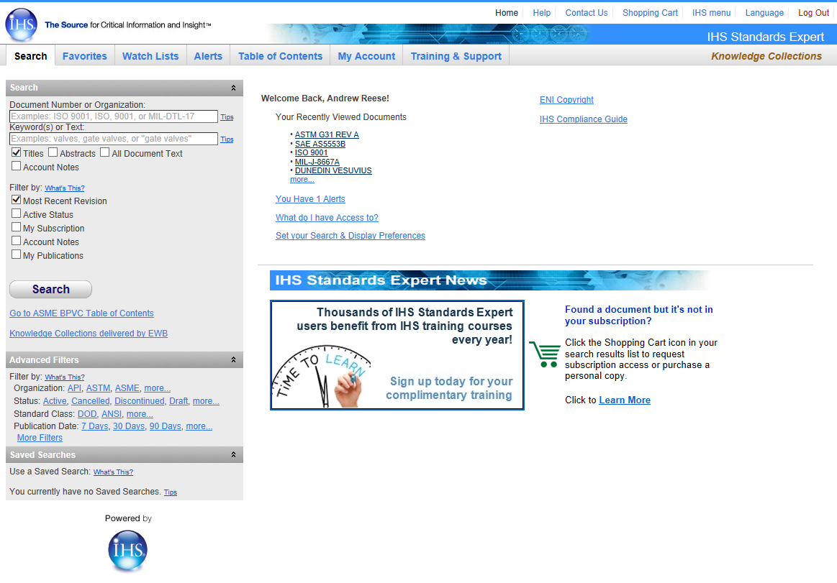
IHS Standards Expert – A Trusted Solution
Enterprise-wide, 24/7 access to critical standards, codes & specifications, plus workflow tools that make engineers more productive
370+
standards organizations worldwide
1.7M+
active & historical standards, codes and specifications

Slide 5
Advancing Standards Management
“Searching should be simplified – it should be easier to find a document”
“It’s hard to find what you need in large documents”
“I’d like to be able to make notes directly within a document”
“46% of workers can find the information they need half the time”
“75% of technical professionals believe it is easier to find knowledge outside of their own organization”
“Intelligent Search” with a single search box and search suggestions
Document Viewer and Table of Contents for faster navigation
Bookmarks and annotations to preserve knowledge in context
Professional reference index and subscriptions. Research assistant search tool
Semantic search engine, single search box, pre-vetted technical content
You Told Us…
We Are Delivering…

Slide 6
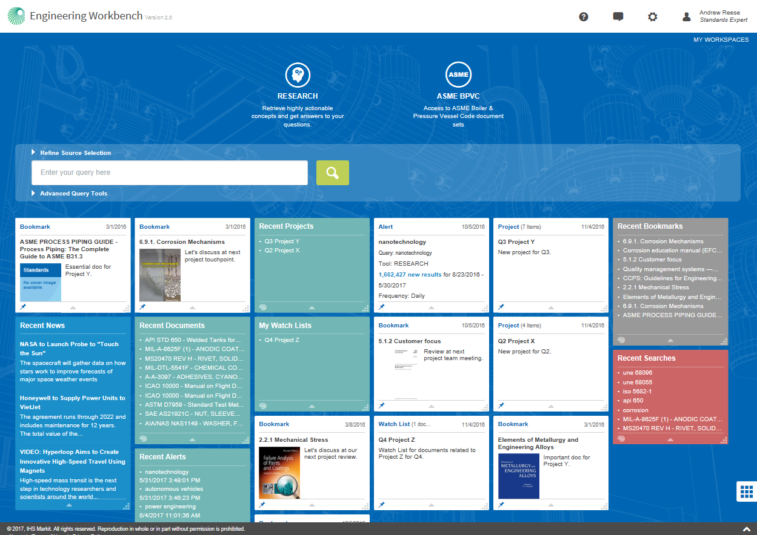
Introducing Engineering Workbench
The future of unified technical knowledge management for engineers and engineering organizations
Single-source access to essential technical reference

Slide 7
Versatile Tool
Meeting Needs of Your Organization and User
© 2016 IHS Markit. All Rights Reserved.

Slide 8
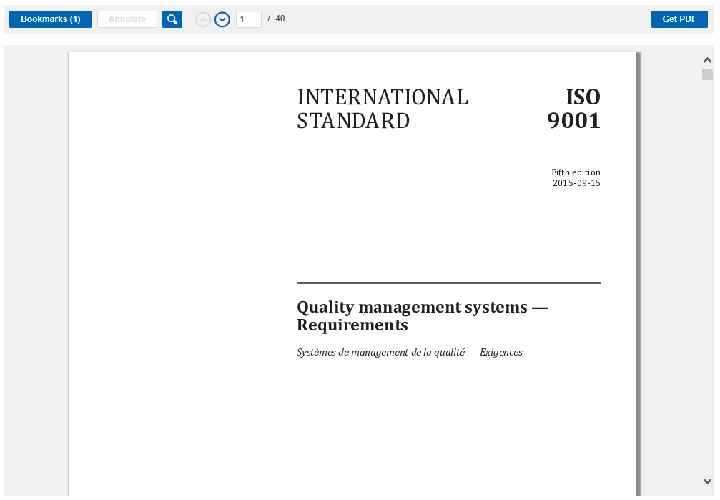
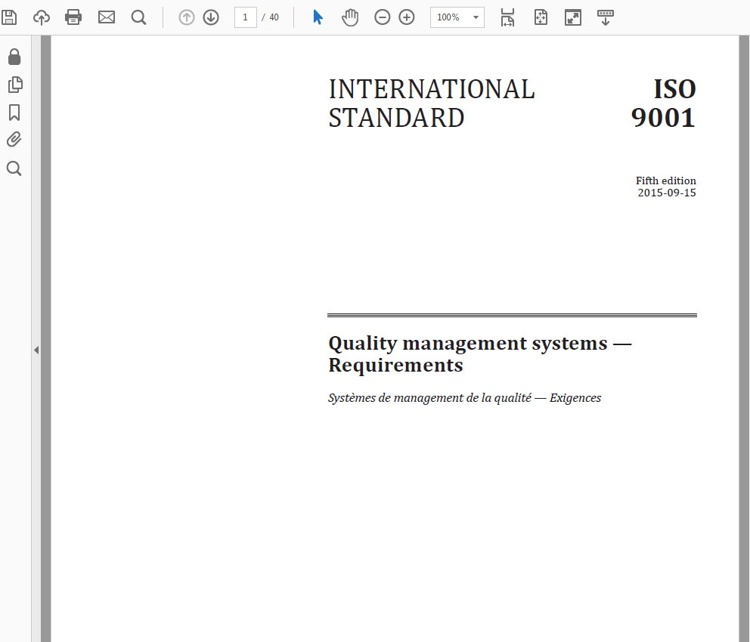
Handling the status quo…
Download a PDF for use offline
You can view and download a PDF of a document.

Slide 9
Standards Productivity Improvements
Faster Search
Bibliographic filtering – (aka “facetted search”)
Sort by Date
Consolidated Query box
Single field for all search activities
New Look
Icon and tile based design

Slide 10
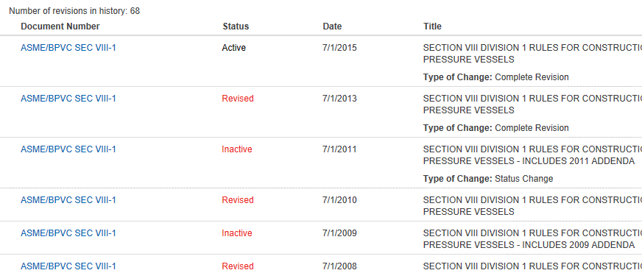
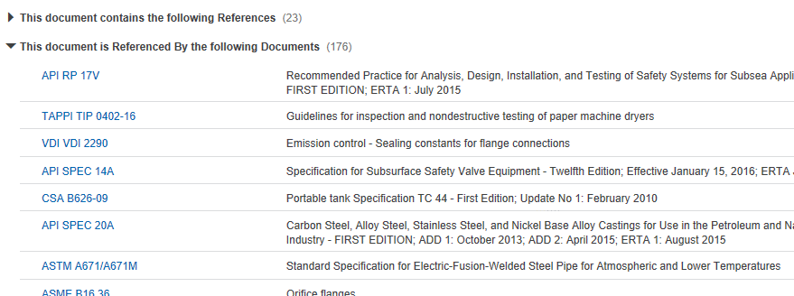
Knowledge Discovery Workflow Improvements…
1
Document Viewer “streams” documents to allow instant access to even very large documents – no waiting for download.
Dynamically generated summaries (1) allow for rapid scanning through large numbers of documents.
Document History (2) and Related Documents (3) let users quickly review the revision history or click through to standards referenced by (or that reference) the document being reviewed.
2
Table of Contents lets users immediately navigate to specific sections.
3
Create Bookmarks for easy access, or Annotations for project notes to preserve knowledge.

Slide 11
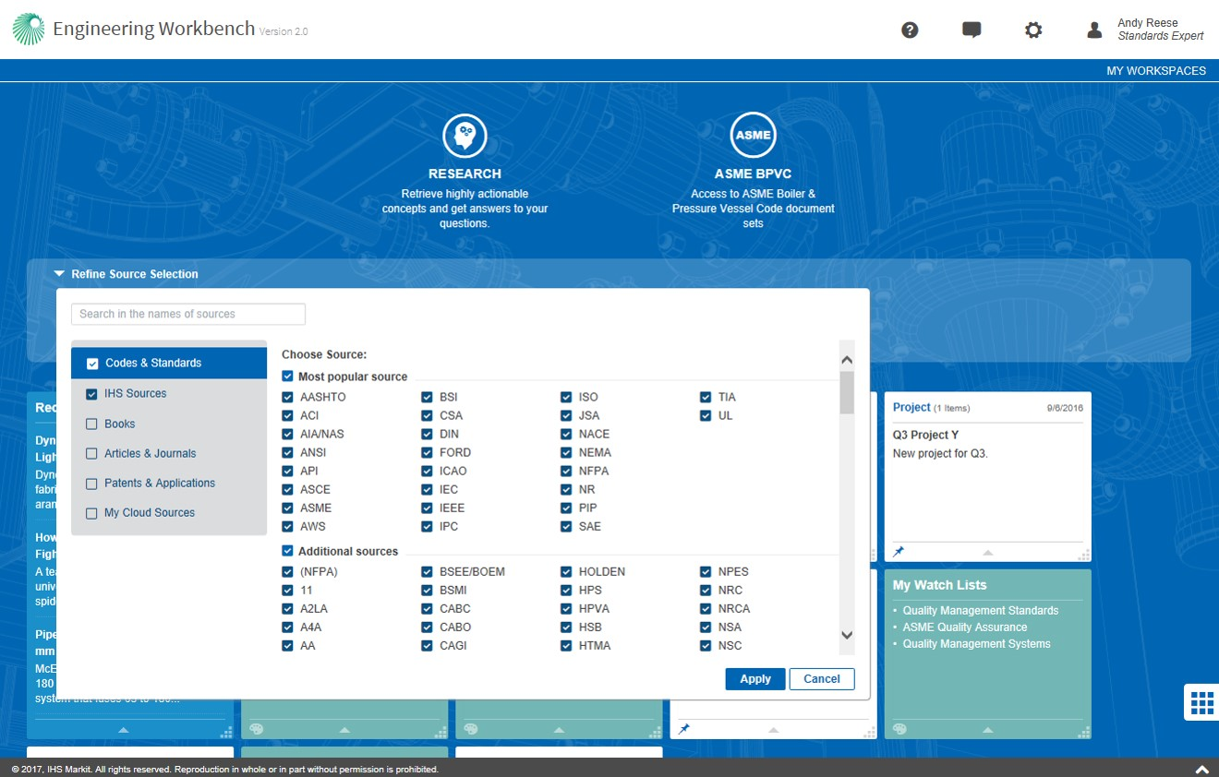
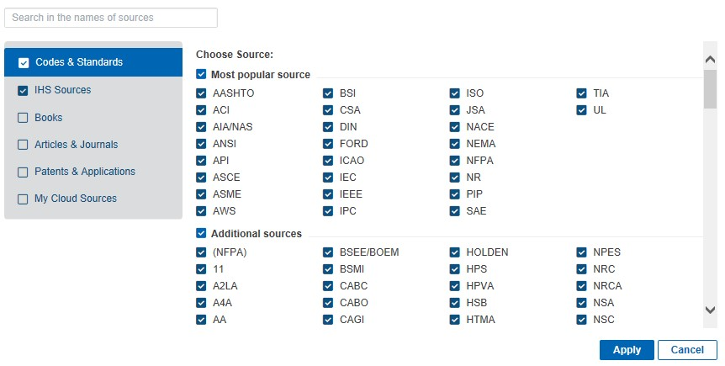
Just want to find a standard?
You can quickly and easily find a standard document by setting your user “role” – or profile – to “Standards Expert only” in order to limit your searches to only Codes & Standards by default.
User role can be set via My Settings under the Tool menu. See this document for more information on setting your user profile/role.
Use “Refine Source Selection” to select the content collections (or “knowledge bases”) that you want to search.
Select knowledge bases to search by clicking on the appropriate tab and selecting the collections to search. For example, you can limit your search to specific standards bodies by only checking “Codes & Standards” and then checking only the desired standards bodies to include in your search.
Search for a standards body by its acronym or name.

Slide 12
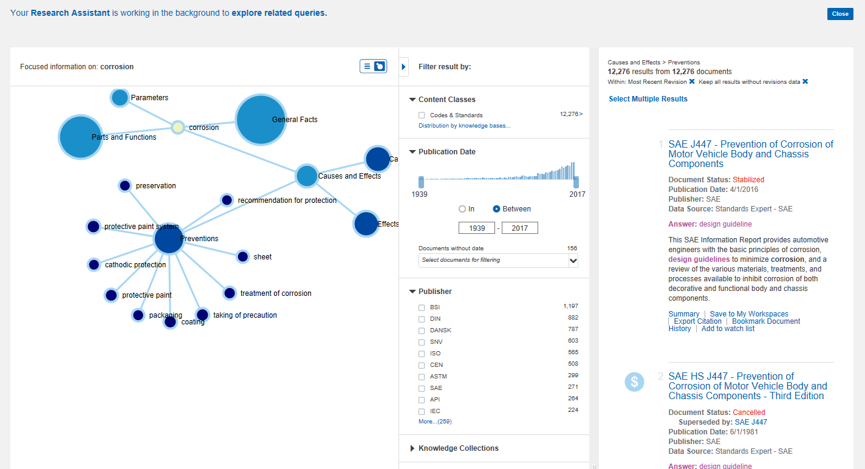
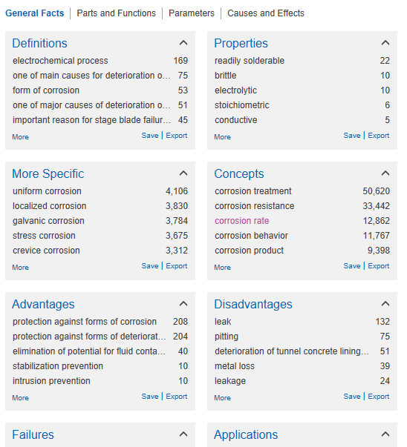
The Research Assistant tool acts like a virtual subject matter expert, guiding you to precise answers in large bodies of content.
Toggle between the graphical interface shown at left and the tabular interface below to explore your content.
Graphical interface lets engineers quickly drill down to solution.
Faceted filters help users easily refine their searches on the fly, based on date, publisher and more.
*Research Assistant is an optional tool that will be visible if included in your organization’s subscription.

Slide 13
January 2017 Engineering Workbench Early Visibility Program launch begins key transition…
“The relevancy of the search results is what we expect and what will make our work much faster, since, in our projects we don’t get paid for the time spent on search”
A greatly improved solution for finding, using and managing standards, codes & specifications...
“This is exactly what we need for our users…a consolidated platform that sends them to one place for all their research”
The first step of a journey to help you deliver more value to your organizations…

Slide 14
Security Improvements
Ensuring Operations Security for Customers

Slide 15
Access security is important
Website access can be at risk for brute force attacks
Personal information is at risk
Security protects individuals, companies and assets

Slide 16
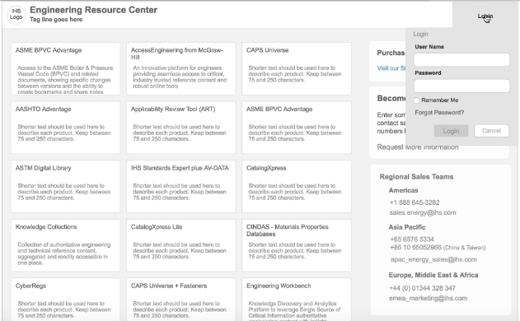
Customer Security Upgrade Options
SAM
Secure Access
Management
Focus on Operational Security
Customer Options for Access
Single sign on with Federated Access
Individual username/password login with new ERC login portal
Account transition is managed at account level
Individual registration is required
Accounts with registration can be auto converted
Single Sign On Federated Access
CUSTOMER
Federated Authentication
https://ihsmarkit/erc
Login Username Password Access
Customer Login Portal

Slide 17
SAM | Single Sign On Federation Access
Use customer’s corporate authentication for secure single sign on to IHS products
Single sign-on with Federated Authentication
Easy secure access to IHS Products
Uses Customer’s existing single sign-on solution
Add IHS as a trusted partner
CUSTOMER
Corporate Travel
Federated Authentication
Company Benefits
IHS ERC Products
Benefits
Secure, single sign on
Share identity information securely
Control access to corporate resources
Secure standard protocols with SAML2.0

Slide 18
Account Management Plan

Slide 19
XXXX EWB Switchover Account Plan
Your are scheduling for Group X switchover
Apr – Aug 2017
May – Sep 2017
Apr – Oct 2017
Early Visibility provided to help your associate’s self-paced migration
Early Visibility provided to help your administrators decide on platform defaults
Tool for your administrators
90 day email template
60 day email template
30 day email template
EWB for standards 1 pager
Customer Checklist
Customer Account Plan Template

Slide 20
IHS Market Action
Customer Action
XXXXXX EWB Switchover Schedule
Apr
May
Jun
Jul
Aug
Training
Early Visibility
begins
Notice #1
Notice #2
Notice #3
Follow up
Notice #1
Notice #2
Notice #3
Checklist Complete
System Check
2.0
Group 1

Slide 21
IHS Market Action
Customer Action
XXXXXX EWB Switchover Schedule
May
Jun
Jul
Aug
Sep
Oct
Training
Early Visibility
begins
Notice #1
Notice #2
Notice #3
Follow up
Notice #1
Notice #2
Notice #3
Checklist Complete
System Check
2.0
Group 2

Slide 22
IHS Market Action
Customer Action
XXXXXX EWB Switchover Schedule
May
Jun
Jul
Aug
Sep
Oct
Nov
Training
Early Visibility
begins
Notice #1
Notice #2
Notice #3
Follow up
Account Planning
Notice #1
Notice #2
Notice #3
Checklist Complete
System Check
2.0
Group 3

Slide 23
Questions and Comments

